Slide 1
Unsupervised Learning:
Clustering
Dr. Sourasekhar Banerjee (Ph.D.)

Slide 2
Intended Learning Outcome
Understand the meaning of clustering
Understand why we cluster data
Understand clustering algorithms (K-Means, K-Means++, DBSCAN, Hierarchical)

Slide 3
Supervised vs Unsupervised
Supervised Learning requires labeled data → Used for prediction.
Unsupervised Learning works with unlabeled data → Used for finding hidden patterns.
Voltage (V) | Capacity (Ah) | SOH (%)
3.7 | 2.0 | H
4.0 | 2.5 | H
3.6 | 1.8 | M
4.1 | 2.7 | L
3.9 | 2.2 | L
Voltage (V) | Capacity (Ah) | CLusters
3.7 | 2.0 | C1
4.0 | 2.5 | C2
3.6 | 1.8 | C1
4.1 | 2.7 | C3
3.9 | 2.2 | C3

Slide 4
Purpose of Clustering
Identify patterns and structures in unlabeled data.
Group similar data points together based on shared characteristics.
Detect anomalies and outliers (e.g., faulty battery cells)
Enhance decision-making by segmenting data into meaningful groups.

Slide 5
Clustering
Clustering is a machine learning technique used to group similar data points together.
It helps in identifying patterns and structures in large datasets without labels.
Groups are formed based on similar characteristics or predefined criteria.

Slide 6
Clustering Approaches
Prototype-based clustering
  Uses centroids or means to represent clusters.
Density based clustering
  Identifies clusters based on high-density regions without using explicit prototypes.
Hierarchical clustering
  Forms a tree-like structure of nested clusters instead of using prototypes.

Slide 7
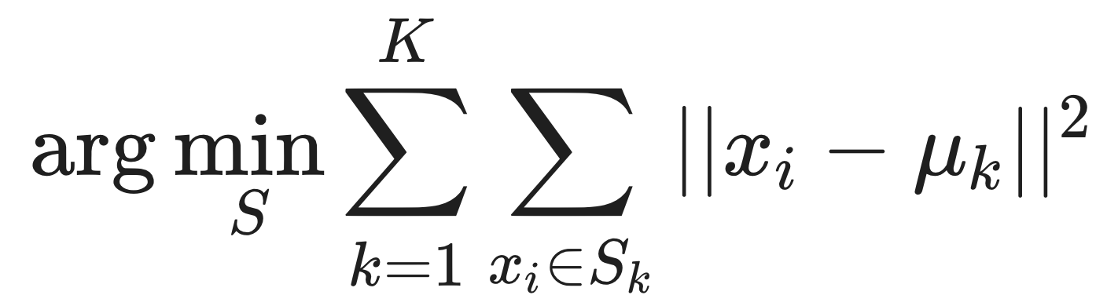
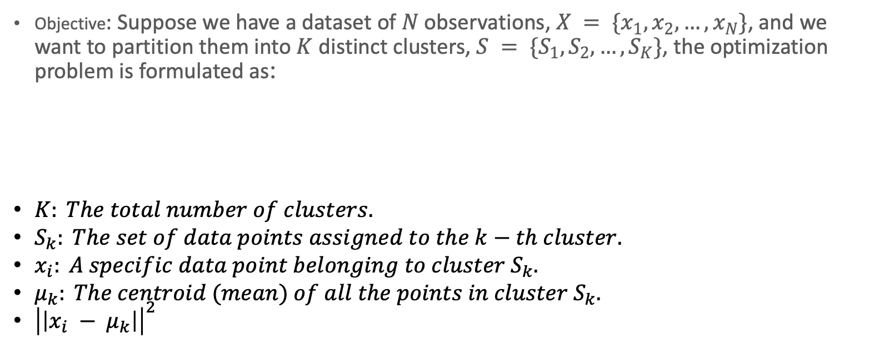
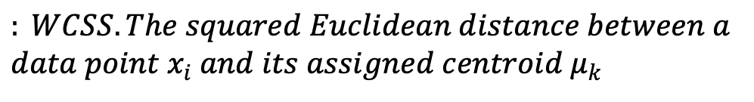
K-Means Clustering
Objective: Suppose we have a dataset of $N$ observations, $X = \{x_{1}, x_{2}, …, x_{N}\}$, and we want to partition them into $K$ distinct clusters, $S = \{S_{1}, S_{2}, …, S_{K}\}$, the optimization problem is formulated as:
$$: WCSS. The squared Euclidean distance between a$$
$$data point x_{i} and its assigned centroid{ μ}_{k}$$

Slide 8
K-means Clustering
Step 1: Select the number of clusters (K) to group the data.
Step 2: Initialize K centroids randomly from the dataset.
Step 3: Assign each data point to the nearest centroid based on distance measures (e.g., Euclidean distance).
Step 4: Compute new centroids as the mean of all points assigned to a cluster.
Step 5: Repeat steps 3 and 4 until centroids no longer change or reach a stopping condition.
Step 6: Final clusters are formed, and the algorithm terminates.

Slide 9
K-Means Example
Iteration 1
Feature 1 | Feature 2 | Centroid 0 (x,y) | Centroid 1 (x,y) | Distance to Centroid 0 (Iter 1) | Distance to Centroid 1 (Iter 1) | Assigned Cluster (Iter 1)
1 | 2 | (1, 2) | (2, 3) | 0 | 1.41 | 0
2 | 3 | (1, 2) | (2, 3) | 1.41 | 0 | 1
3 | 3 | (1, 2) | (2, 3) | 2.24 | 1 | 1
6 | 8 | (1, 2) | (2, 3) | 7.81 | 6.4 | 1
7 | 9 | (1, 2) | (2, 3) | 9.22 | 7.81 | 1
8 | 8 | (1, 2) | (2, 3) | 9.22 | 7.81 | 1
Iteration 2
Feature 1 | Feature 2 | Centroid 0 (x,y) | Centroid 1 (x,y) | Distance to Centroid 0 (Iter 1) | Distance to Centroid 1 (Iter 1) | Assigned Cluster (Iter 1)
1 | 2 | (1.0, 2.0) | (5.2, 6.2) | 0 | 5.94 | 0
2 | 3 | (1.0, 2.0) | (5.2, 6.2) | 1.41 | 4.53 | 0
3 | 3 | (1.0, 2.0) | (5.2, 6.2) | 2.24 | 3.88 | 0
6 | 8 | (1.0, 2.0) | (5.2, 6.2) | 7.81 | 1.97 | 1
7 | 9 | (1.0, 2.0) | (5.2, 6.2) | 9.22 | 3.33 | 1
8 | 8 | (1.0, 2.0) | (5.2, 6.2) | 9.22 | 3.33 | 1

Slide 10
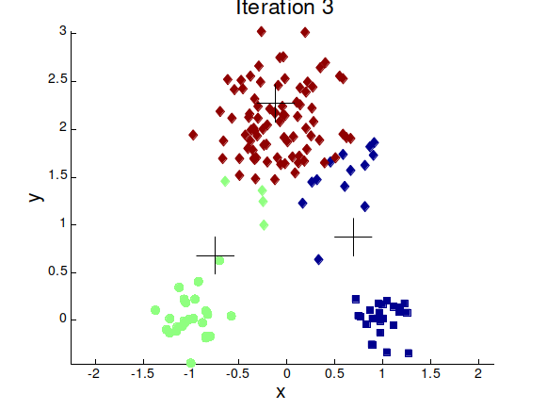
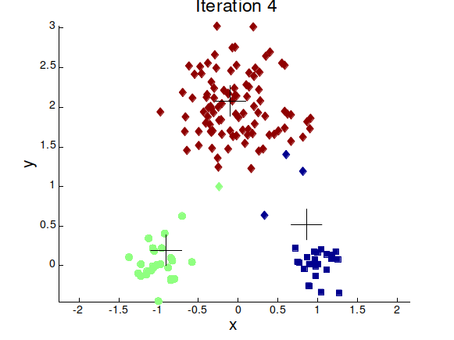
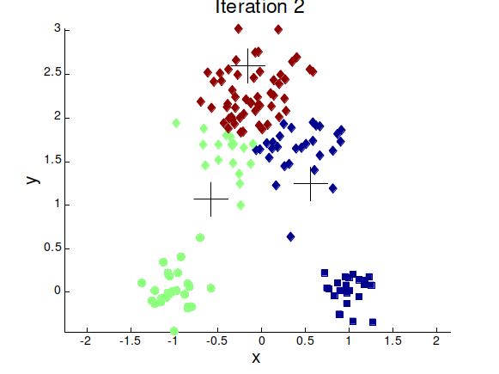
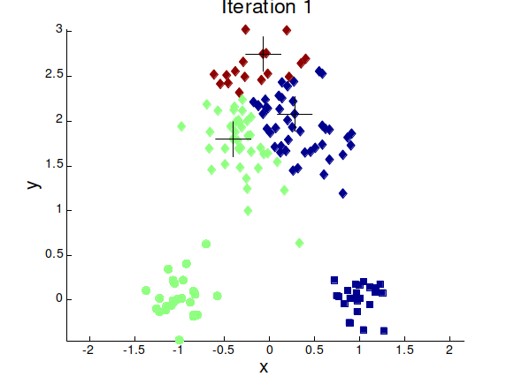


K-Means Example

Slide 11
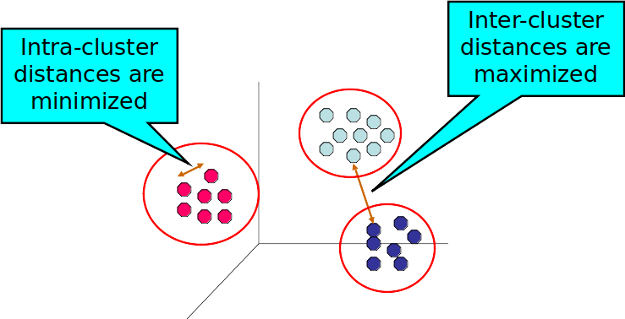
Clustering

Slide 12
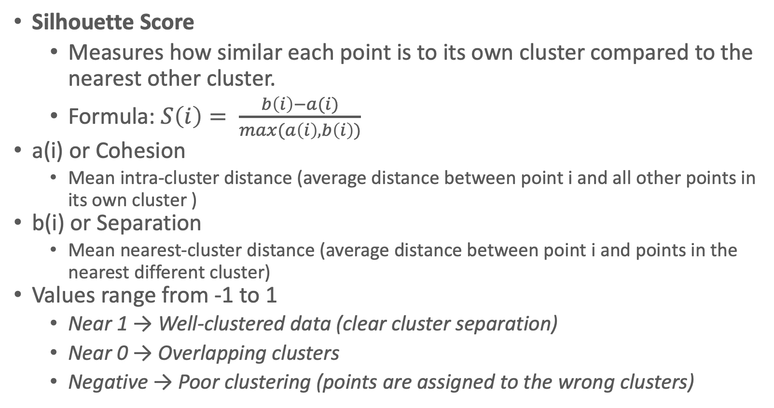
Cluster Quality Measurement
Silhouette Score
  Measures how similar each point is to its own cluster compared to the nearest other cluster.
  Formula: $S\left(i\right)= \frac{b\left(i\right)−a(i)}{max(a\left(i\right),b\left(i\right))}$
a(i) or Cohesion
  Mean intra-cluster distance (average distance between point i and all other points in its own cluster )
b(i) or Separation
  Mean nearest-cluster distance (average distance between point i and points in the nearest different cluster)
Values range from -1 to 1
  Near 1 → Well-clustered data (clear cluster separation)
  Near 0 → Overlapping clusters
  Negative → Poor clustering (points are assigned to the wrong clusters)

Slide 13
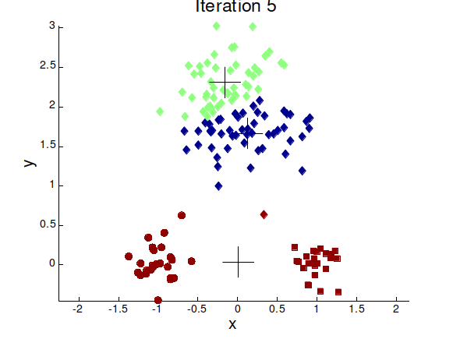
Importance of the Choice of Initial Centroid
Example with 2 different Initial centroid can generate two different clusters

Slide 14
Drawbacks of K-Means Algorithm
Convergence Speed: Poorly chosen centroids can lead to slow convergence or unnecessary iterations.
Local Minima: K-Means is an iterative optimization algorithm that may get stuck in local minima, leading to suboptimal clustering.
Cluster Quality: If the centroids are not well-initialized, clusters may be unbalanced or incorrectly formed, reducing clustering effectiveness.
Reproducibility: Random initialization can lead to different results for different runs, making clustering inconsistent.
Sensitivity to Outliers: Outliers can significantly distort the centroid positions, reducing clustering accuracy.
Predefined Number of Clusters: The number of clusters (K) must be specified in advance, which may not align with the actual data distribution.
Shape and Size Assumptions: K-Means performs best with round and evenly sized clusters, making it unsuitable for irregularly shaped or unevenly distributed clusters.

Slide 15
K-Means++
Address the issue of random centroid initialization.
Algorithm
  Choose the First Centroid: Select the first centroid randomly from the data points.
  Select Subsequent Centroids:
    For each remaining centroid, calculate the squared distance of each data point to the nearest centroid.
    Assign a probability to each point based on its distance, with farther points having a higher chance of being selected.
    Select the next centroid based on this probability distribution.
    Repeat Until All K Centroids Are Chosen: Continue the process until all K centroids are initialized.
  Proceed with Standard K-Means: After initialization, the algorithm continues with the regular K-Means steps.

Slide 16
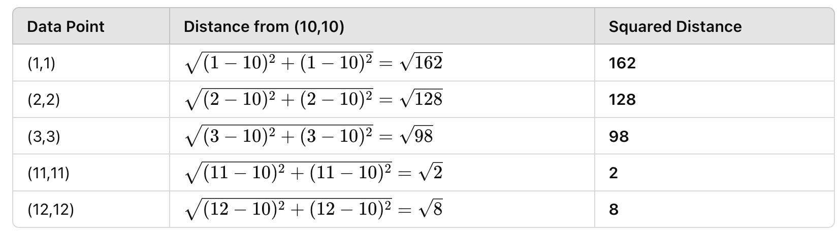
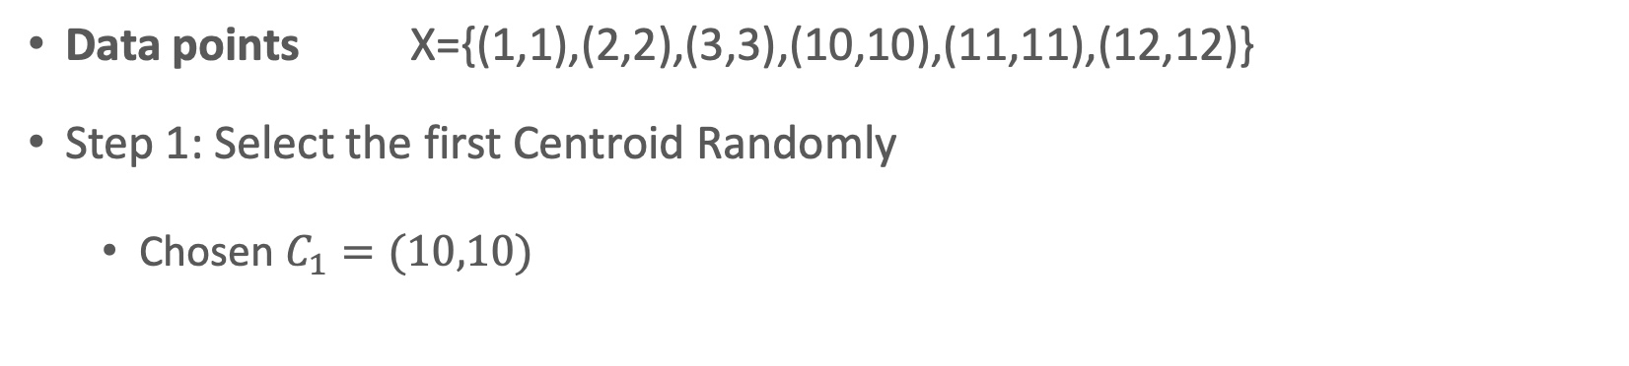
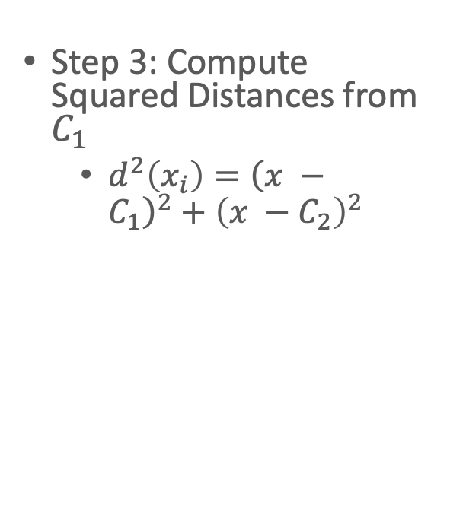
Example
Data points X={(1,1),(2,2),(3,3),(10,10),(11,11),(12,12)}
Step 1: Select the first Centroid Randomly
  Chosen $C_{1}=(10,10)$
Step 3: Compute Squared Distances from $C_{1}$
  $d^{2}\left(x_{i}\right)={\left(x −C_{1}\right)}^{2}+{\left(x −C_{2}\right)}^{2}$

Slide 17
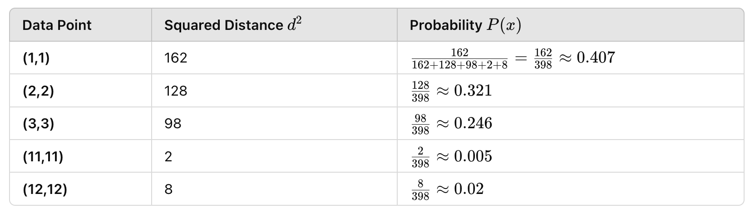
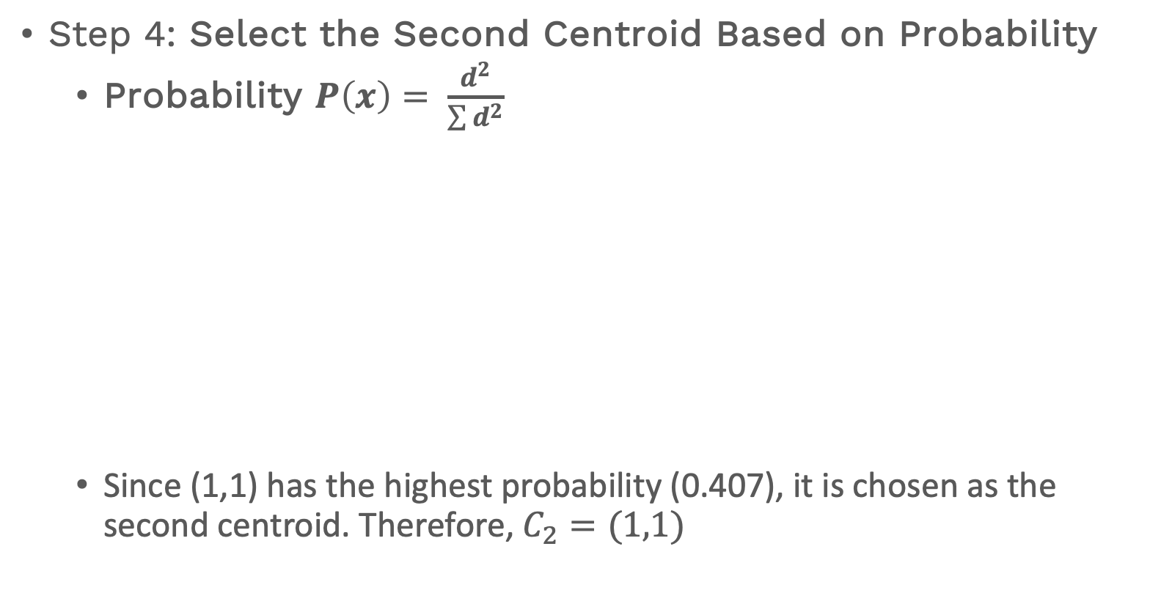
Example
Step 4: Select the Second Centroid Based on Probability
  Probability $P\left(x\right)= \frac{d^{2}}{\sum{d^{2}}}$
  Since (1,1) has the highest probability (0.407), it is chosen as the second centroid. Therefore, $C_{2}=(1,1)$

Slide 18
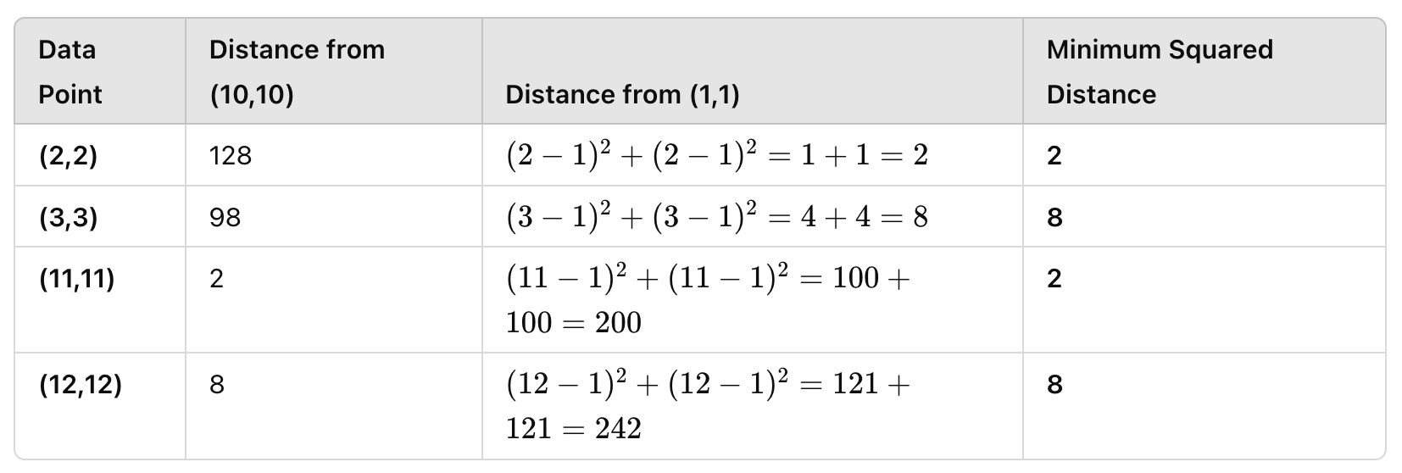
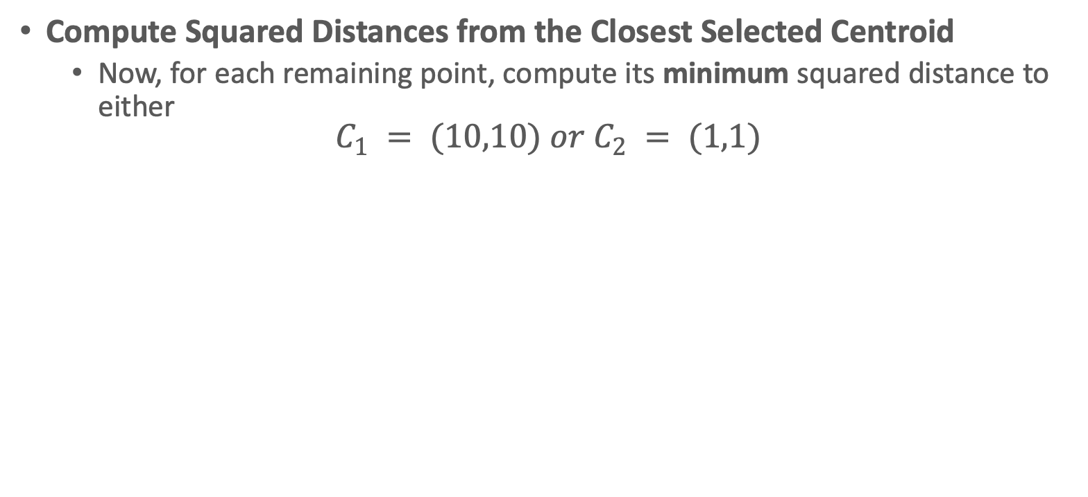
Example
Compute Squared Distances from the Closest Selected Centroid
  $\text{Now}\text{, }\text{for} \text{each} \text{remaining} \text{point}\text{, }\text{compute} \text{its} \text{minimum} \text{squared} \text{distance} \text{to} \text{either}$
$$C_{1} = (10,10) or C_{2} = (1,1)$$

Slide 19
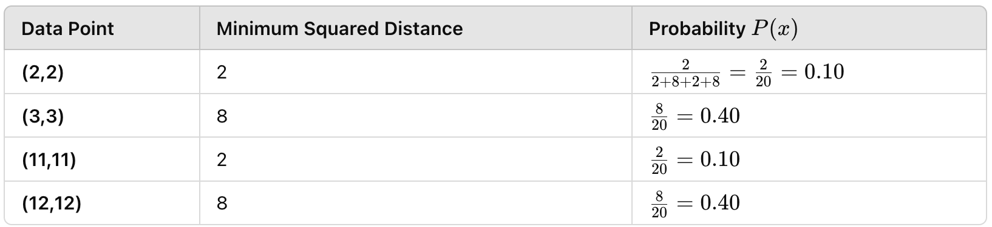
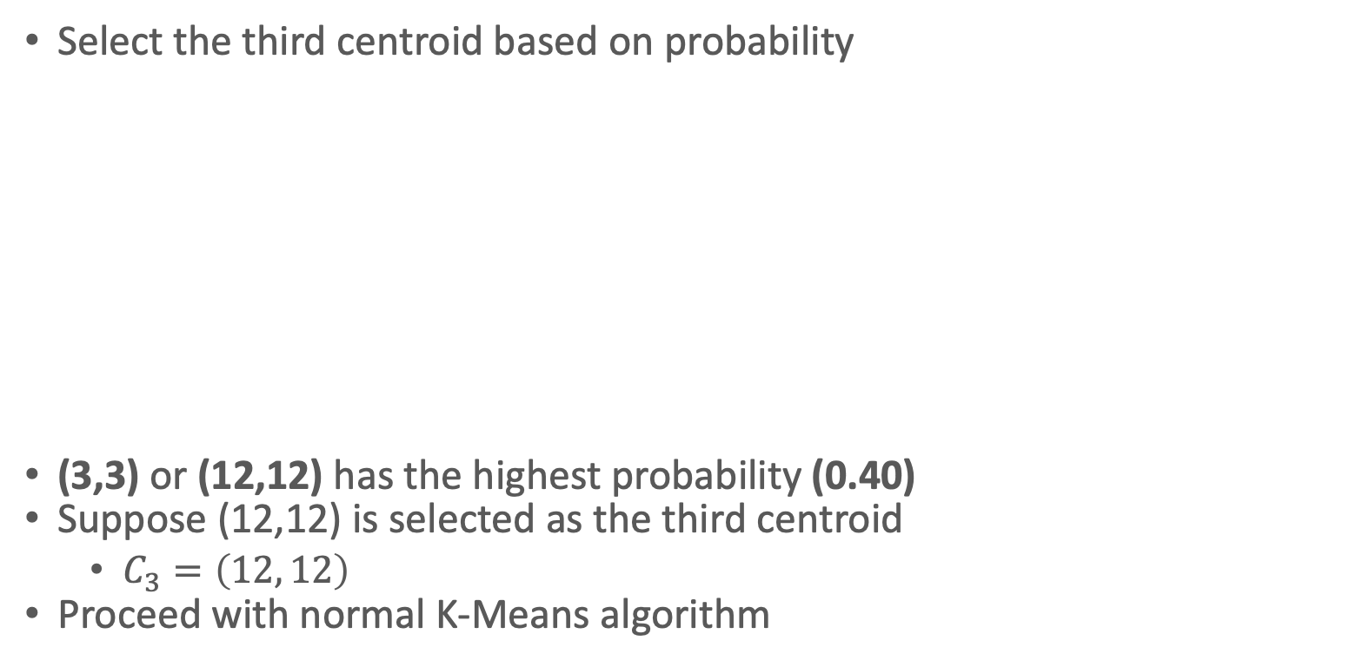
Example
Select the third centroid based on probability
(3,3) or (12,12) has the highest probability (0.40)
Suppose (12,12) is selected as the third centroid
  $C_{3}=\left(12, 12\right)$
Proceed with normal K-Means algorithm

Slide 20
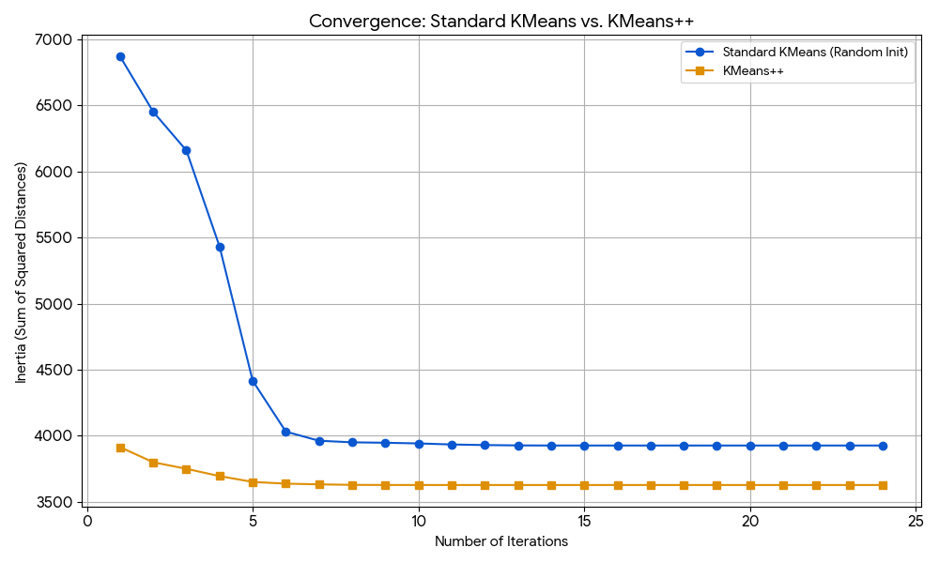
K-Means vs K-Means++
Enhanced spread of centroids: K-Means++ helps ensure that they are placed more effectively, making it less likely that clusters will overlap or be poorly defined.
Better Convergence: Since the initialization process in K-Means++ results in centroids being placed farther apart from each other and away from dense data areas, the algorithm tends to converge more quickly to a reasonable solution.
Robustness: The improved initialization also makes K-Means++ more robust to datasets with varying densities, shapes, and sizes of clusters

Slide 21
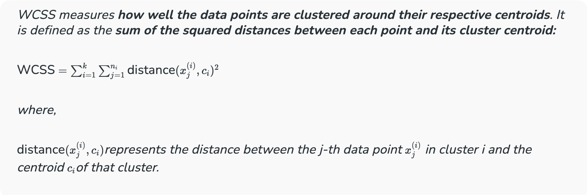
How to Determine K?
The Elbow Method helps us find this optimal k value.
  We iterate over a range of k values, typically from 1 to n (where n is a hyper-parameter you choose).
  For each k, we calculate the Within-Cluster Sum of Squares (WCSS).

Slide 22
The Elbow Point
We calculate a distance measure called WCSS (Within-Cluster Sum of Squares). This tells us how spread out the data points are within each cluster.
We try different k values (number of clusters). For each k, we run KMeans and calculate the WCSS.
We plot a graph with k on the X-axis and WCSS on the Y-axis.

Slide 23
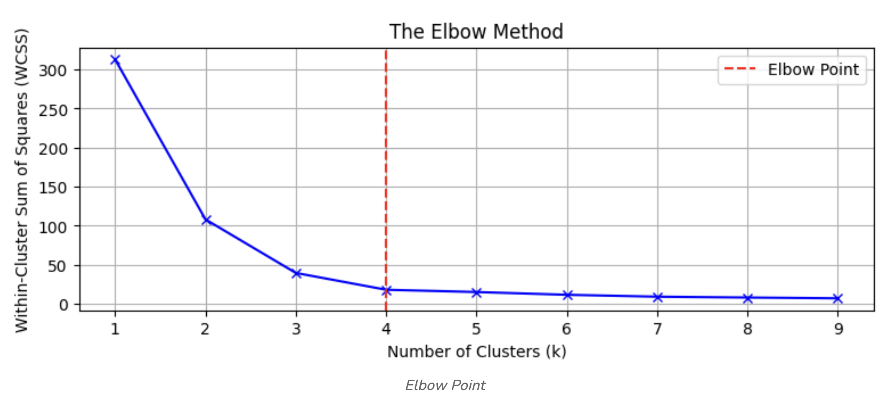
The Elbow Point
Identifying the Elbow Point
  Increase in K , decrease in WCSS
  More clusters allow the model to capture more specific details and variations in the data.
  Adding more clusters provides only a marginal decrease in WCSS.
  Before the elbow
    Increasing k significantly reduces WCSS
    Indicating that new clusters effectively capture more of the data’s variability.
  After the elbow
    Adding more clusters results in a minimal reduction in WCSS,
    Extra clusters may not be necessary and could lead to overfitting.

Slide 24
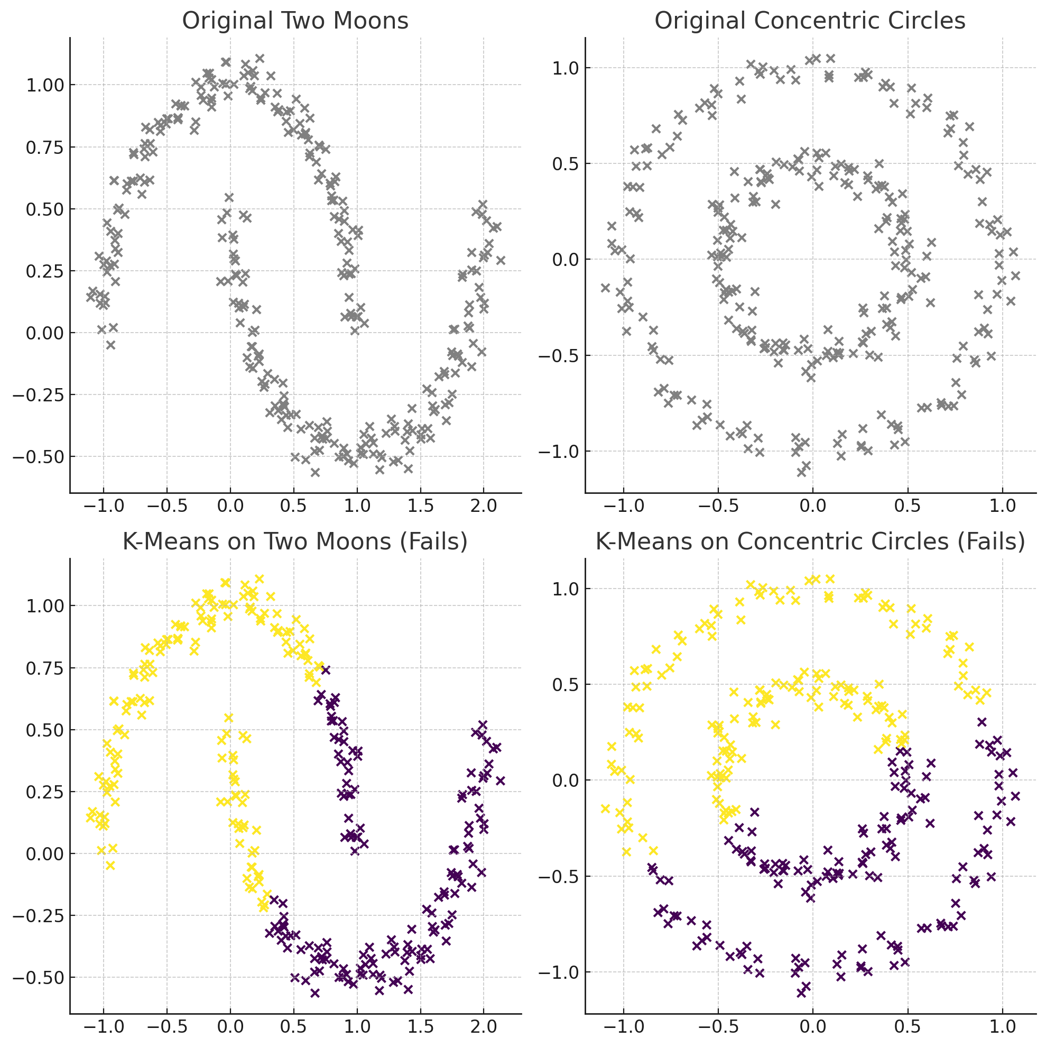
Limitations of K-Means: Handling non-Globular Shapes
K-Means relies on Euclidean distance to measure similarity, which causes problems when:
Clusters have irregular shapes (e.g., concentric circles, spirals)
Clusters are connected by curved or non-linear boundaries
Clusters have varying densities.
Notes:
The term "globular" refers to the shape of clusters, meaning spherical or compact clusters. In clustering, a globular cluster is one where the data points are grouped closely around a central point, resembling a sphere (or hypersphere in higher dimensions)

Slide 25
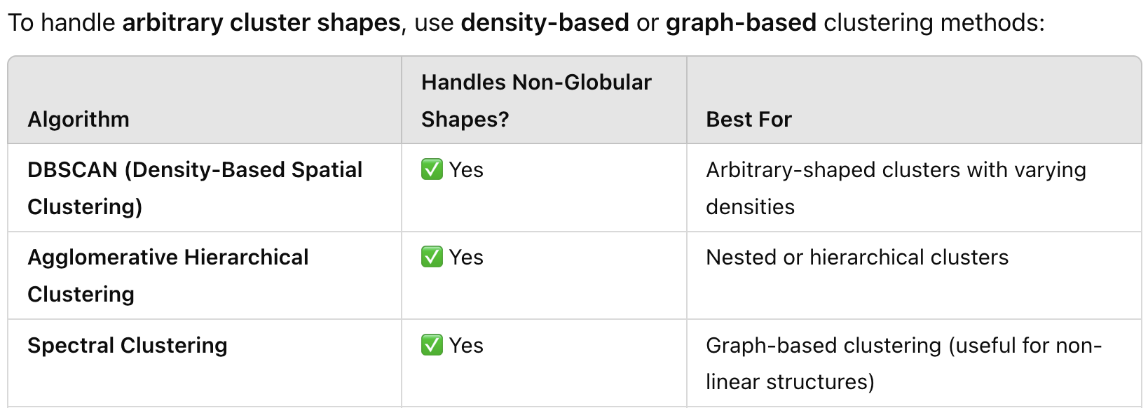
Alternatives to K-Means for Non-Globular Clusters

Slide 26
DBSCAN (Density-Based Spatial Clustering of Applications with Noise)
DBSCAN is a density-based algorithm
Density = number of points within a specified radius (Eps)
A point is a core point if it has at least a specified number of points (MinPts) within Eps
  These are points that are at the interior of a cluster
  Counts the point itself
A border point is not a core point but is close to a core point
A noise point is any point that is not a core point or a border point

Slide 27
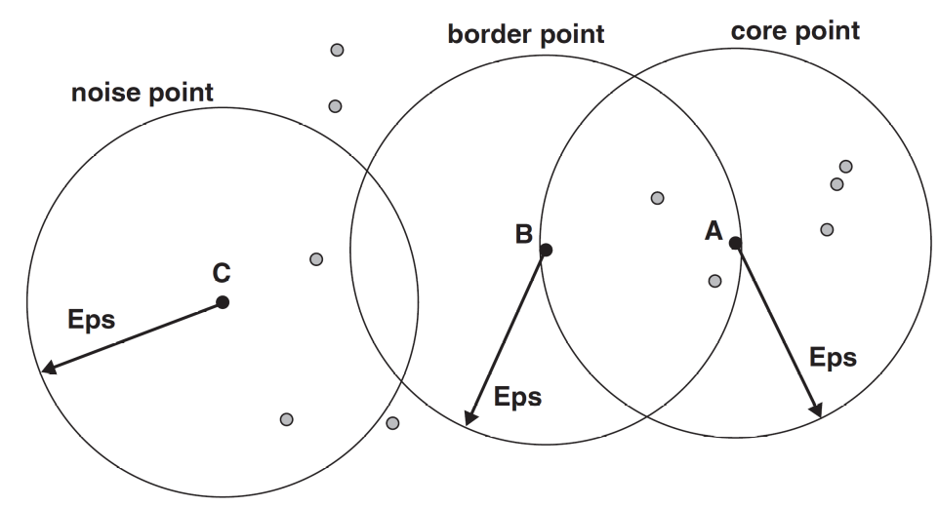
DBSCAN: Core, Border and Noise
MinPts = 7

Slide 28
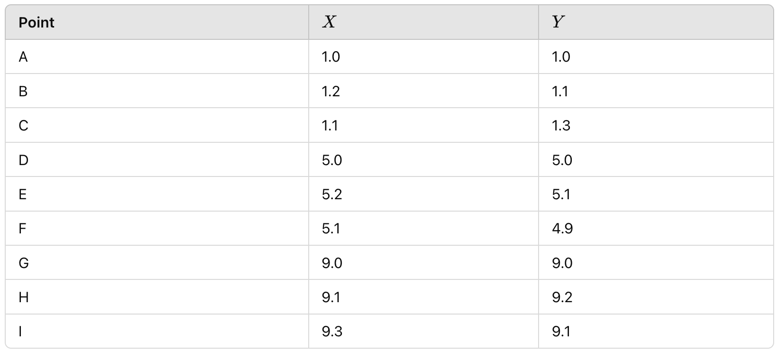
Example
Given 9 Datapoints in a 2D space

Slide 29
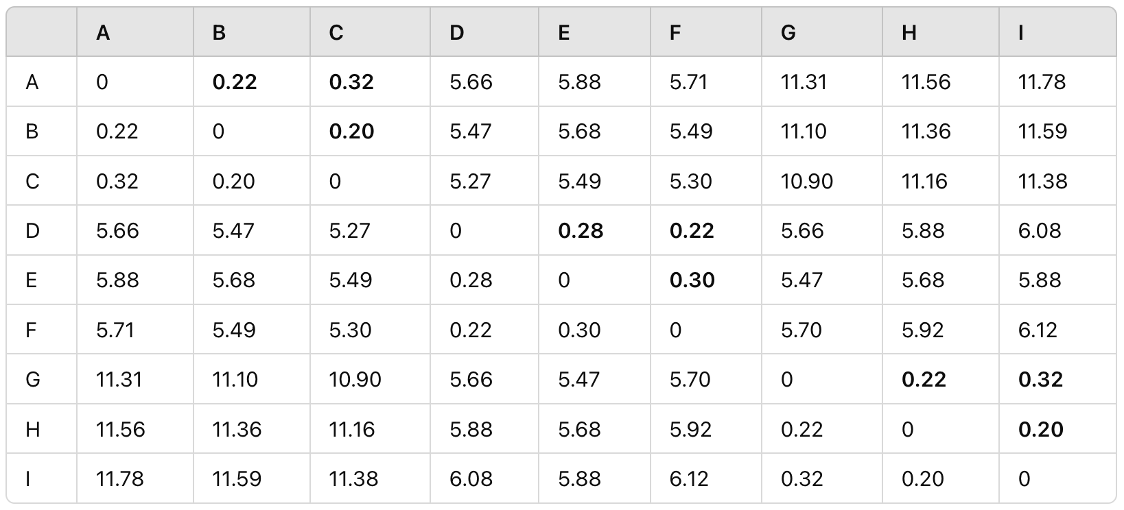
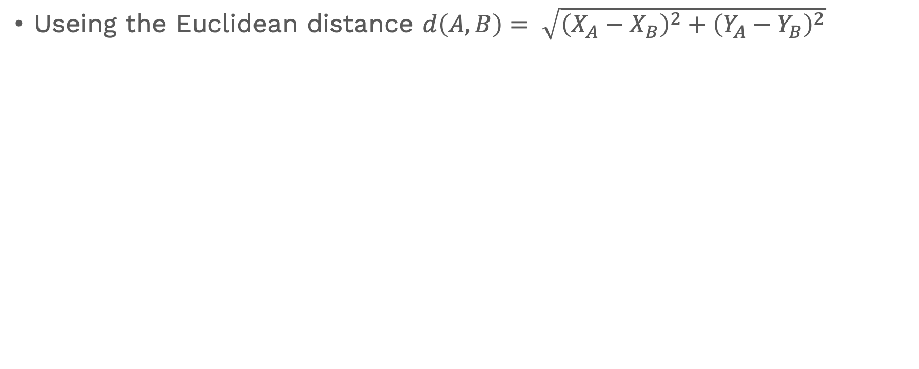
Compute Pair-wise Distance
Useing the Euclidean distance $d\left(A,B\right)= \sqrt{{\left(X_{A}−X_{B}\right)}^{2}+{\left(Y_{A}−Y_{B}\right)}^{2}}$

Slide 30
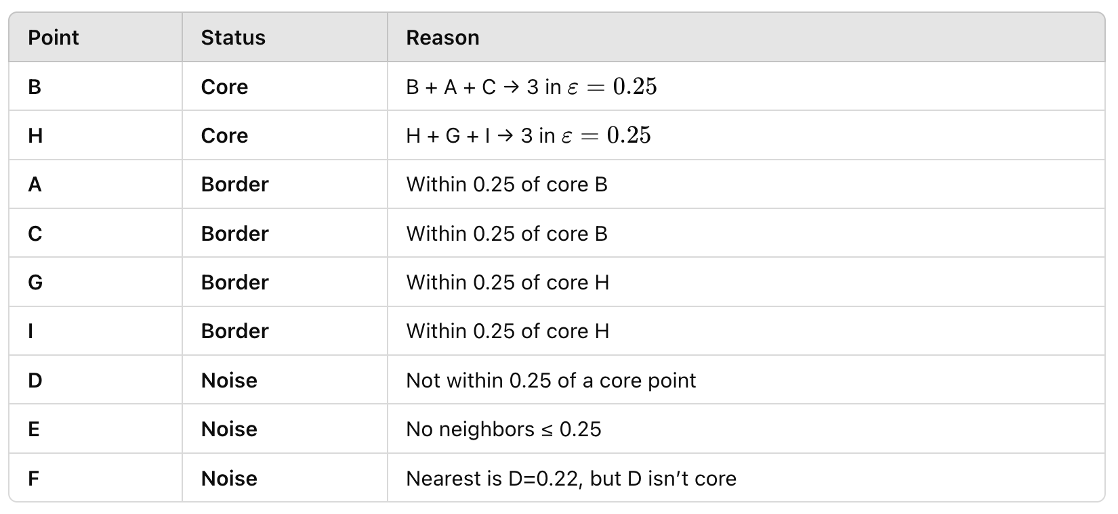
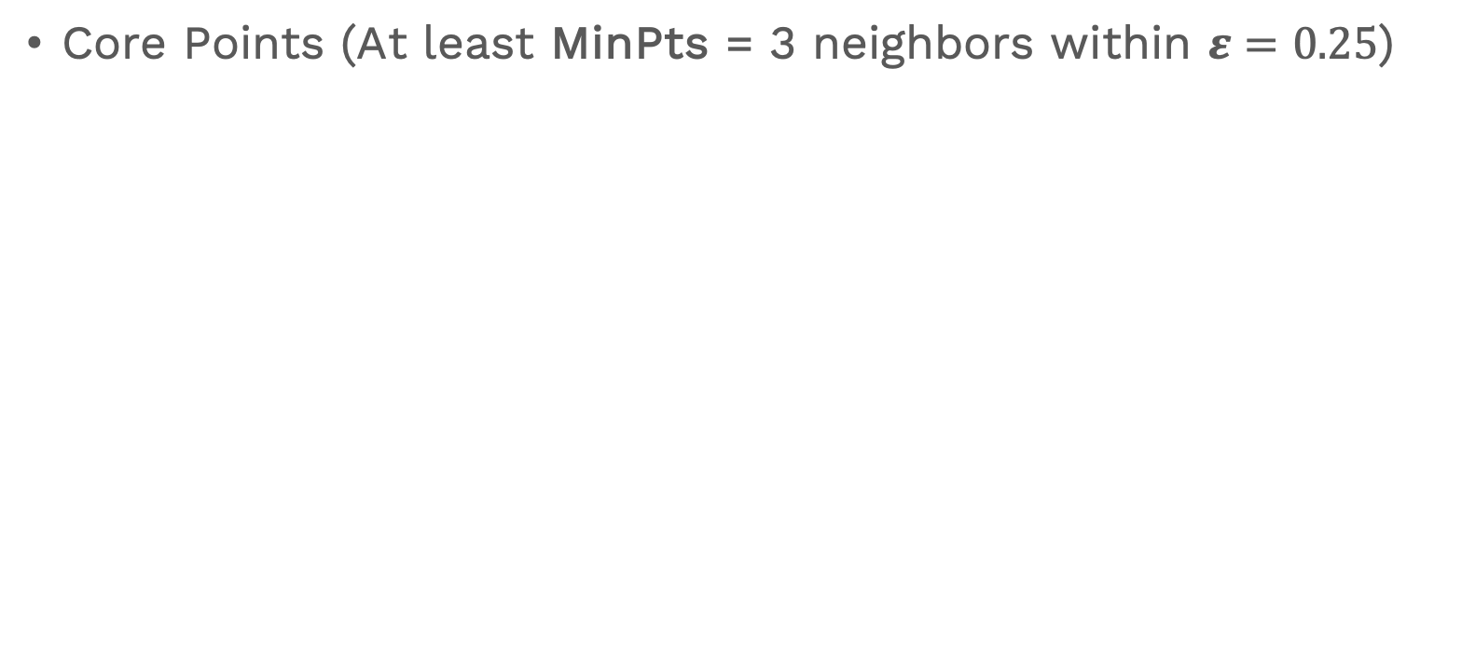
Identify Core, Border, and Noise Points
Core Points (At least MinPts = 3 neighbors within $ε=0.25$)

Slide 31
Cluster Formation
Cluster 1 (centered around B):
  B (core),
  A (border),
  C (border)
Cluster 2 (centered around H):
  H (core),
  G (border),
  I (border)}
Noise: {D, E, F}

Slide 32
DBSCAN: Determining EPS and MinPts
MinPts
  If D is the dimension of dataset, D+1 ≤ MinPts ≤ 2D
  If data is noisy choose values close to 2D
Eps
  Smaller EPS → Many points are considered noise.
  Larger EPS → Different clusters may merge incorrectly
  As soon as you choose MinPts’ value, then you can estimate a good value for Eps using Elbow method.

Slide 33
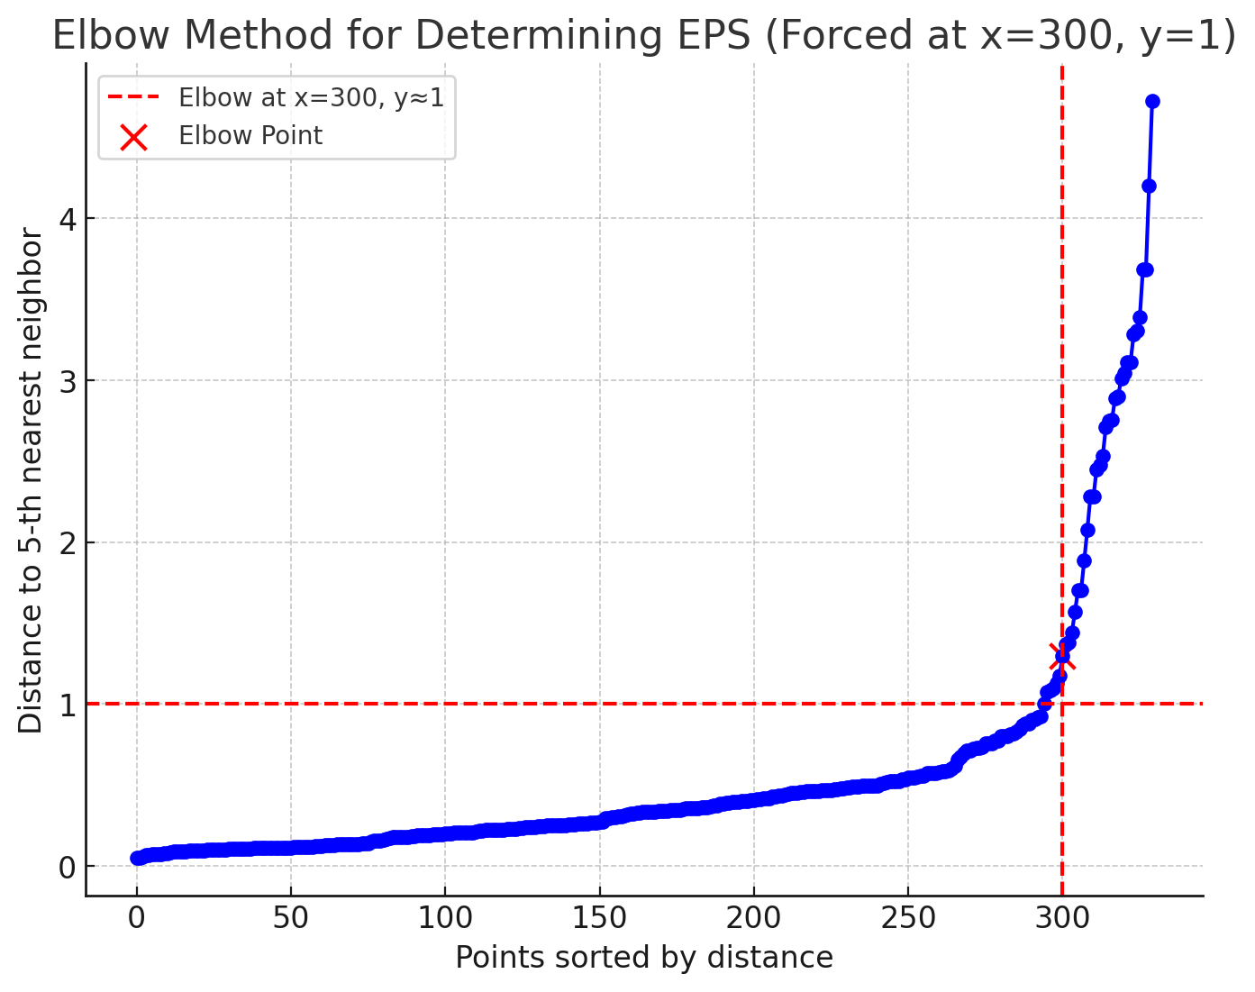
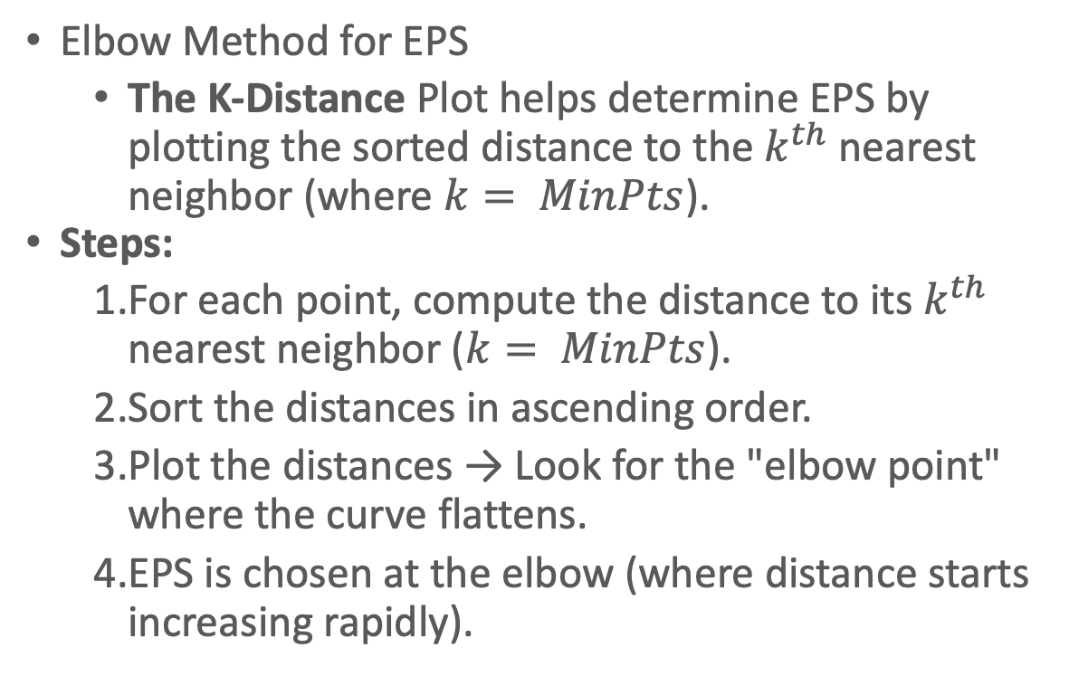
DBSCAN: Determining EPS and MinPts
Elbow Method for EPS
  The K-Distance Plot helps determine EPS by plotting the sorted distance to the $k^{th}$nearest neighbor (where $k= MinPts$).
Steps:
  For each point, compute the distance to its $k^{th}$ nearest neighbor ($k= MinPts$).
  Sort the distances in ascending order.
  Plot the distances → Look for the "elbow point" where the curve flattens.
  EPS is chosen at the elbow (where distance starts increasing rapidly).

Slide 34
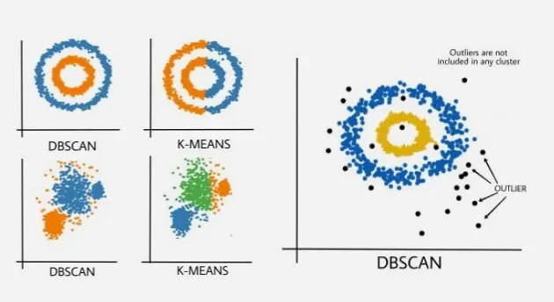
DBSCAN vs K-Means

Slide 35
DBSCAN Vs K-Means
DBSCAN | K-Means
In DBSCAN we need not specify the number of clusters. | It is very sensitive to the number of clusters (k), which must be specified in advance.
Clusters formed in DBSCAN can be of any arbitrary shape. | Clusters formed are spherical or convex in shape
It can work well with datasets having noise and outliers | It does not work well with outliers data. Outliers can skew the clusters in K-Means to a very large extent.
In DBSCAN two parameters are required for training the Model | In K-Means only one parameter is required is for training the model

Slide 36
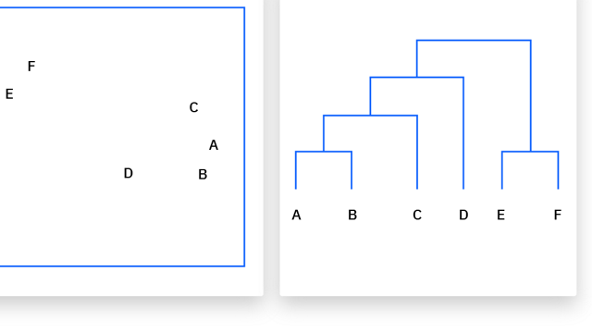
Hierarchical clustering
Building "hierarchy" or a tree of clusters
Unlike K-Means or DBSCAN, which just hand you a final set of flat groupings, hierarchical clustering shows you the exact step-by-step relationship between every single data point

Slide 37
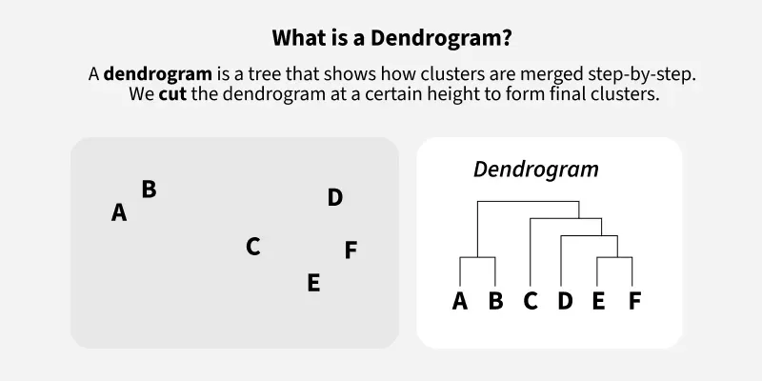
Dendogram
A tree show how clusters merged step-by-step.
We cut the dendogram at a certain height to form final clusters.

Slide 38
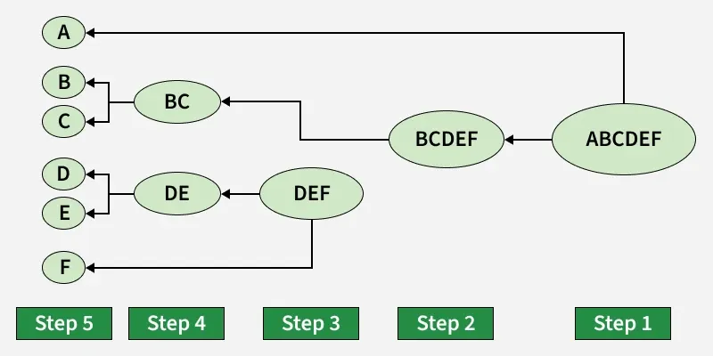
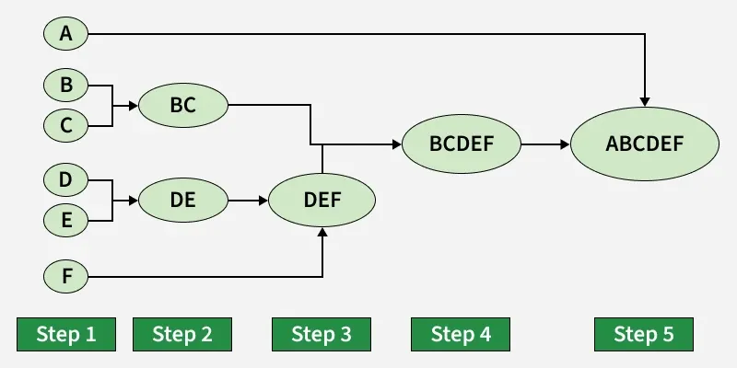
Approaches
Divisive (Top-Down):
  It starts with all data points in one massive cluster.
  It then finds the best way to split that cluster into two,
  keeps splitting the sub-clusters until every data point is entirely on its own.
Agglomerative (Bottom-Up):
  It starts by treating every single data point as its own individual cluster.
  Then, it finds the two closest clusters and merges them into one.
  It repeats this process over and over until all points are merged into a single, giant cluster.

Slide 39
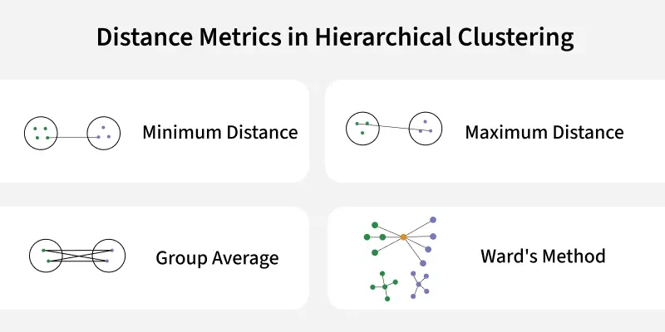
How Do We Measure "Closest"? (Linkage Criteria)
Single Linkage: Measures the distance between the closest two points in each cluster. (Tends to create long, chaining clusters)
Complete Linkage: Measures the distance between the furthest two points in each cluster. (Tends to create tight, spherical clusters).
Average Linkage: Calculates the average distance between all points in cluster A and all points in cluster B.
Ward's Method: Merges clusters in a way that minimizes the total variance within the new cluster (very similar to the WCSS objective in K-Means).

Slide 40
Example
Scenario 3: What if we merge B (5) and C (6)?
The new center: The average of 5 and 6 is 5.5.
The spread (WCSS): How far are B and C from 5.5?
  Distance from 5 to 5.5 is 0.5. Squared = 0.25.
  Distance from 6 to 5.5 is 0.5. Squared = 0.25.
  Total WCSS for this merge = 0.25 + 0.25 = 0.5
A = 2, B = 5, C = 6
Starting WCSS = 0
Scenario 1: What if we merge A (2) and B (5)?
The new center: The average of 2 and 5 is 3.5.
The spread (WCSS): How far are A and B from 3.5?
  Distance from 2 to 3.5 is 1.5. Squared = 2.25.
  Distance from 5 to 3.5 is 1.5. Squared = 2.25.
  Total WCSS for this merge = 2.25 + 2.25 = 4.5
Scenario 2: What if we merge A (2) and C (6)?
The new center: The average of 2 and 6 is 4.
The spread (WCSS): How far are A and C from 4?
  Distance from 2 to 4 is 2. Squared = 4.
  Distance from 6 to 4 is 2. Squared = 4.
  Total WCSS for this merge = 4 + 4 = 8.0
Ward's method looks at the results of these three hypothetical scenarios:
Merging A & B increases WCSS by 4.5
Merging A & C increases WCSS by 8.0
Merging B & C increases WCSS by only 0.5
Because Ward's method strictly wants to keep clusters as tight and compact as possible, it chooses the merge that adds the least amount of variance. Therefore, it merges points B and C first.

Slide 41
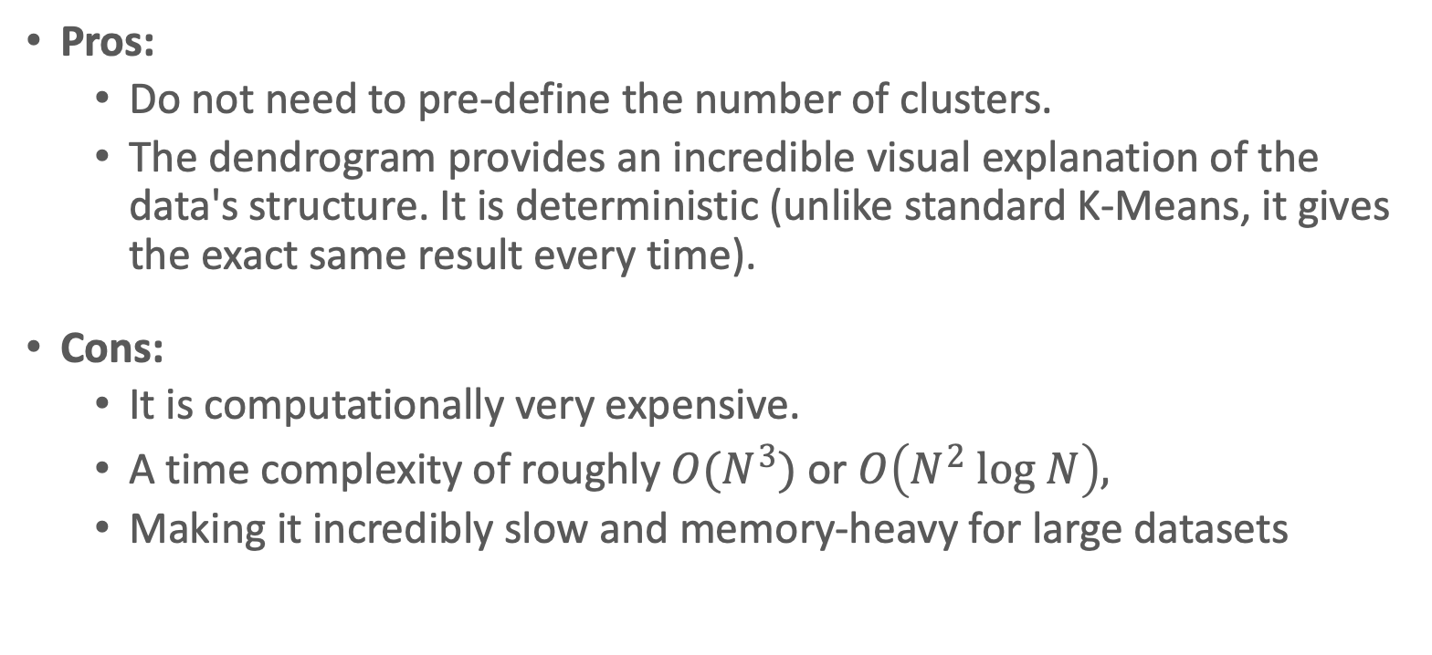
Pros and cons
Pros:
  Do not need to pre-define the number of clusters.
  The dendrogram provides an incredible visual explanation of the data's structure. It is deterministic (unlike standard K-Means, it gives the exact same result every time).
Cons:
  It is computationally very expensive.
  A time complexity of roughly$O(N^{3})$or $O\left(N^{2} log N\right),$
  Making it incredibly slow and memory-heavy for large datasets

Slide 42
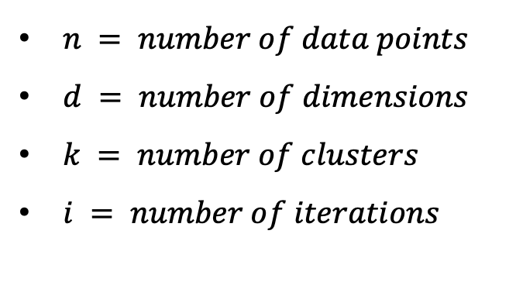
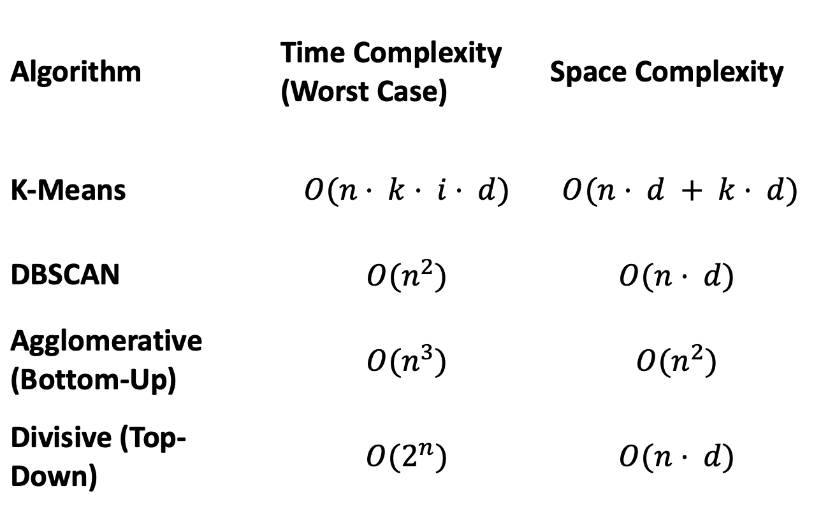
Computation
Complexity
Algorithm | Time Complexity (Worst Case) | Space Complexity
K-Means | $$O(n⋅ k⋅ i⋅ d)$$ | $$O(n⋅ d + k⋅ d)$$
DBSCAN | $$O(n^{2})$$ | $$O(n⋅ d)$$
Agglomerative (Bottom-Up) | $$O(n^{3})$$ | $$O(n^{2})$$
Divisive (Top-Down) | $$O(2^{n})$$ | $$O(n⋅ d)$$

Slide 43
Hands-on

Slide 44
Some Research Questions
Uploaded in Stadium (Lecture (16/2) - Introduction to Clustering)

Slide 45

A small survey for my Colleague

Slide 46
Thank You!

